Slide 1


Introduction to OMOP Common Data Model
FarajaMH 2026
Michael Ochola

Slide 2
Content Outline
1
2
3
4
5
Data model
Common Data Model
OMOP CDM
Harmonization
OMOP tables
How databases organize things and relationships
Why different sources need a shared structure
What OMOP standardizes
How source data gets mapped into OMOP
Where patients, visits, conditions, drugs and measurements live

Slide 3
What is a data model
A data model is a way of describing:
●
THINGS
✓
FACTS
↔
RELATIONSHIPS
e.g., person, visit, diagnosis, medication
e.g., age, blood pressure, diagnosis date
e.g., a person has visits; a visit may have a diagnosis
A blueprint for how data is organized.

Slide 4
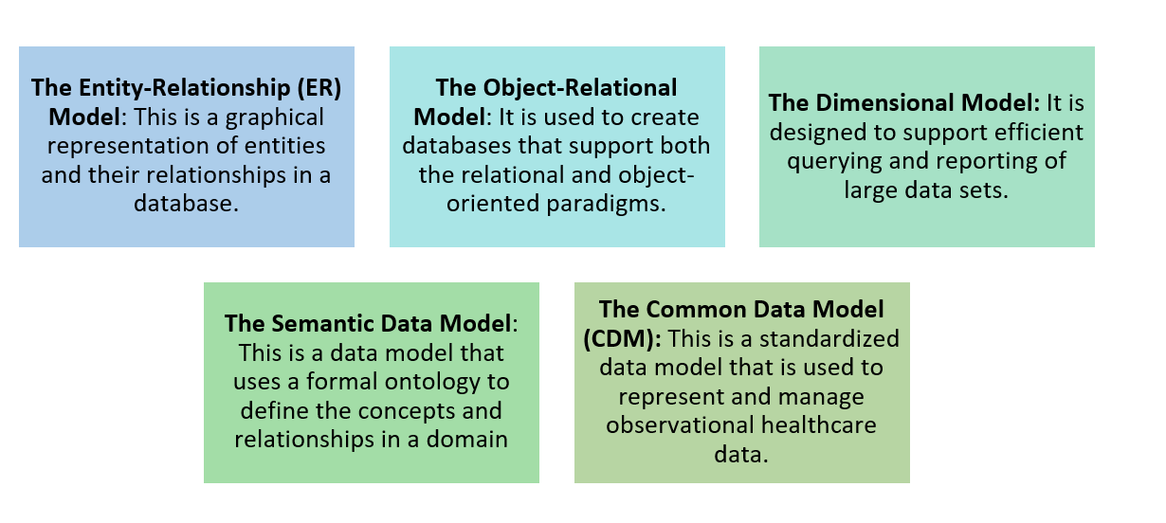
Types of Data Models

Slide 5
Data standardization terminologies
Data structure : tables, fields, data types
Data protocols : set of rules that govern how data are represented
Data vocabularies : terminologies to codify clinical domains
Cohort definition : algorithms for identifying the set of patients who meet a collection of criteria for a given interval of time
Covariate construction : logic to define variables available for use in statistical analysis
Analysis : collection of decisions and procedures required to produce aggregate summary statistics from patient-level data
Results reporting : series of aggregate summary statistics presented in tabular and graphical form

Slide 6
The Common Data Model
Common Data Model (CDM)- a CDM is used to standardize and facilitate the exchange, pooling, sharing, or storing of data from multiple sources.
CDMs specify structure, format, and (to varying degrees) content of data to be pooled or shared
OMOP provides a standardized framework for organizing and querying observational health
★
OMOP CDM
EHR
Registry
Research study
Descriptive Analysis
Cohort Studies
Federated Analysis
common structure + standardized vocabularies
source data
source data
source data
OMOP does not mean “one database.” It is a common way to organize data.

Slide 7
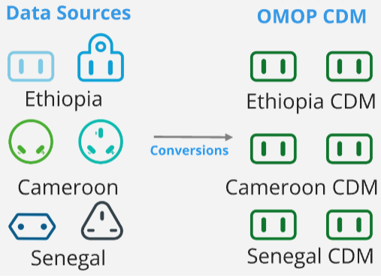
Data harmonization and standardization
What
Process of integrating and standardizing varying data sources, structures and formats into a common data model(CDM).
How
Through data transformations and vocabulary integration.
Why
Facilitates use of common tools for data analysis
Data sharing
Contributes to the FAIR principle

Slide 8
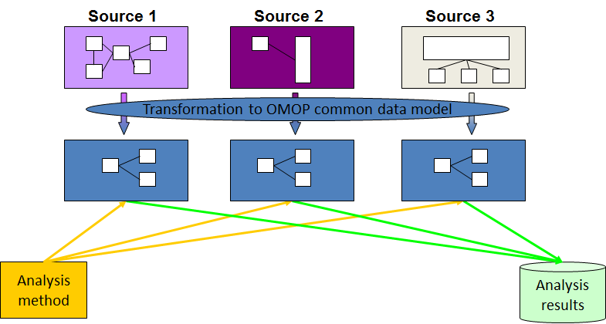
Data harmonization and standardization
The Observational Medical Outcomes Partnership (OMOP) Common Data Model (CDM) is a standardized framework for organizing and querying electronic health record (EHR) data.
It is designed to enable researchers to use real-world data from multiple sources

Slide 9
Why use OMOP CDM?
Standardization
Interoperability
Reusable analysis
Common structure and terminology
Exchange and work across systems
Common tools can be applied to standardized data
Flexibility
Quality improvement
Sharing & collaboration
Designed to accommodate different data sources
Consistent representation supports data quality work
Facilitates sharing and exchange across organizations
Ultimately: standardize once, reuse many times.

Slide 10
OMOP CDM Table Categories
People
Care
Conditions
PERSON • DEATH
VISIT • CARE_SITE • PROVIDER
CONDITION_OCCURRENCE
Treatment
Measurements & facts
DRUG_EXPOSURE • PROCEDURE_OCCURRENCE
MEASUREMENT • OBSERVATION • DEVICE_EXPOSURE
Sample OMOP CDM Tables

Slide 11
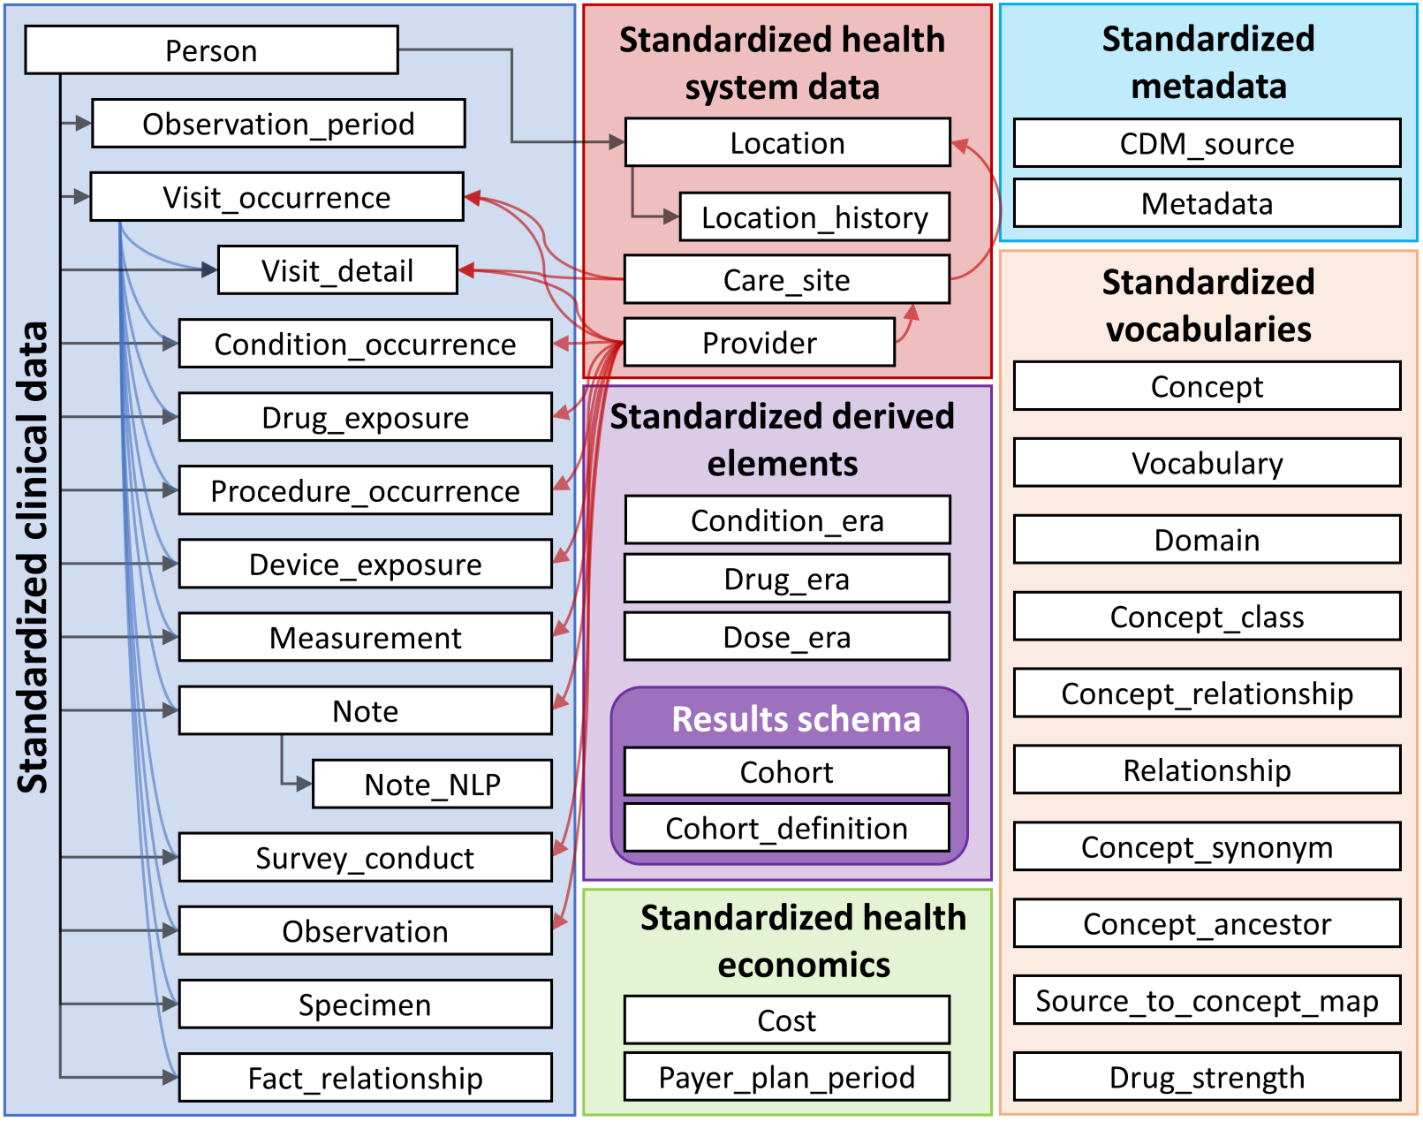
Database Tables within OMOP CDM

Slide 12
Database Tables within OMOP CDM
TABLE | DESCRIPTION
Person | The central entity representing individuals/patients in the dataset.
Observation period | Links a person to one or more time periods during which their data was collected
Visit_occurence | Represents instances of patient visits to healthcare facilities.
Condition occurrence | Stores information about diagnoses or medical conditions recorded during patient encounters.
Drug exposure | Contains records of medications prescribed or administered to a patient.
Procedure occurrence | Stores data on medical or surgical procedures performed on the patient.
Measurement | Contains clinical measurements such as lab test results or vitals like blood pressure.
Observation | Represents clinical facts or observations recorded during healthcare encounters (e.g., smoking status, lifestyle factors).
Device Exposure | Stores records of medical devices used in patient care, such as pacemakers or ventilators
Care site | Represents healthcare facilities where visits or procedures occurred.
Provider | Represents healthcare professionals associated with the patient's care.
Death | Stores information on patients who have died, including the cause of death.

Slide 13
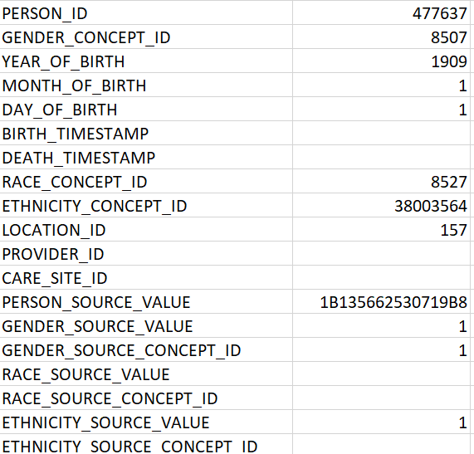
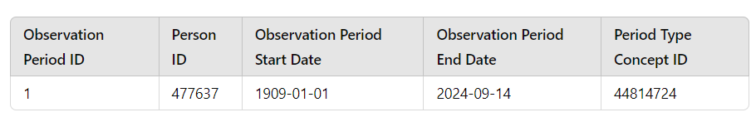
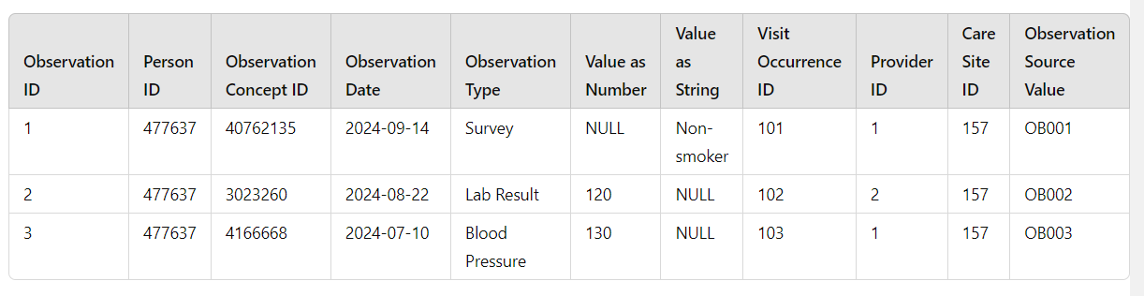
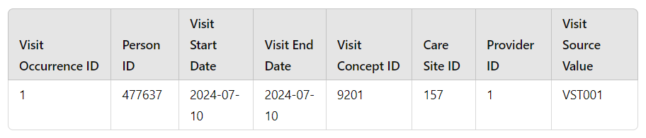
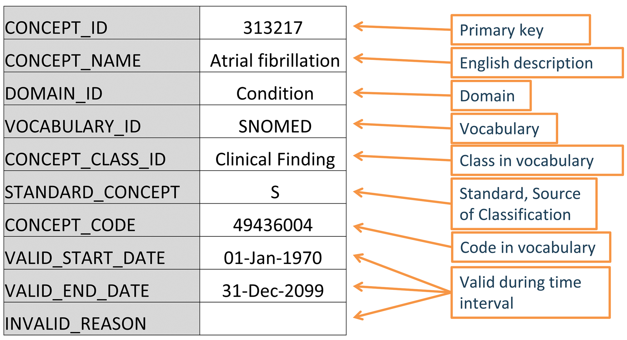
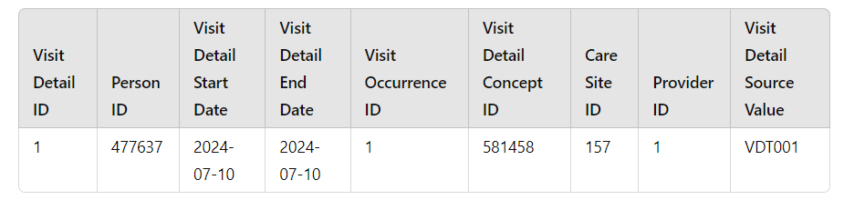
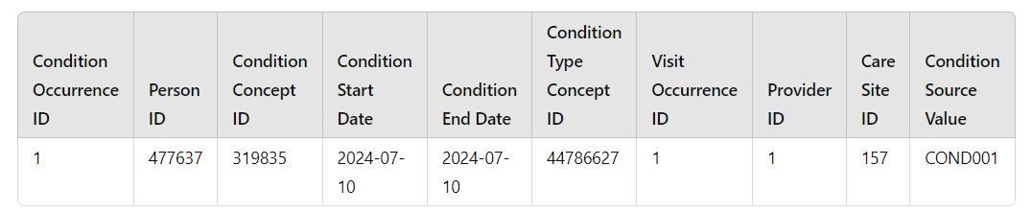
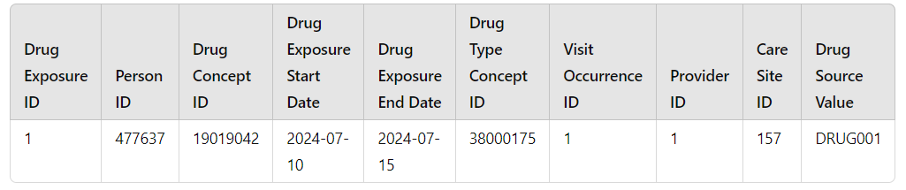
Database Tables within OMOP CDM
PERSON
OBSERVATION PERIOD
OBSERVATION
VISIT OCCURENCE
CONCEPT
VISIT DETAIL
CONDITION OCCURENCE
DRUG EXPOSURE

Slide 14


THANK YOU
@APHRC
@aphrc
www.aphrc.org

